Slide 1

Project Stage-I Presentation on
Nyaya AI
Ajeenkya DY Patil School of Engineering, Pune
Imparting quality education in the field of Artificial Intelligence and Data Science
Department of Artificial Intelligence & Data Science Engineering
AY: 2026-27 Group ID- Class: BE SEM-I
Guided by
Prof. Pooja Dehankar
Presented by:
Members
1 Pranit Tupe (Team Lead)
2 Omkar Tilekar
3 Raj Yeole
4 Yash Limbhore

Slide 2
Department Vision
Imparting quality education in the field of Artificial Intelligence and Data Science.
Department Mission
To include the culture of R and D to meet the future challenges in AI and DS.
To develop technical skills among students for building intelligent systems to solve problems.
To develop entrepreneurship skills in various areas among the students.
To include moral, social and ethical values to make students best citizens of country.
Institute Vision
Empowerment through quality technical education.
Institute Mission
To excel as a center of excellence in technical education.
To impart skill-based education to meet the needs of industry and society.
To achieve excellence in teaching, learning and research.
To inculcate social and ethical values among the students.

Slide 3
Flow of Presentation
Abstract
Introduction
Problem Statement
Motivation
Literature Survey
Project Work flow
System Architecture/Algorithm
References

Slide 4
Introduction
Project Name: Nyaya AI (न्याय AI)
Core Concept: An AI-powered judicial intelligence platform designed specifically for the Indian Legal System.
Target Audience: Practicing Advocates and Judges.
Key Functionalities: Automated FIR document ingestion via OCR, statutory mapping (IPC, CrPC, BNS), exact precedent retrieval, and AI-driven evidentiary assistance.
Architecture: A decoupled client-server setup utilizing a dual-collection Retrieval-Augmented Generation (RAG) system to strictly separate statutory rules from historical case precedents.

Slide 5
Motivation
Efficiency in Justice Delivery: To drastically reduce the time taken for courtroom preparation by automating the extraction of core facts from messy, real-world inputs like First Information Reports (FIRs) and charge sheets.
Eradicating AI Hallucinations: To build a trustworthy system that prevents the LLM from confusing a judge's subjective opinion with a hard statutory law by using an isolated, two-step database architecture.
Practical Applicability: To provide advocates with highly relevant evidentiary suggestions and drafting assistance based strictly on historical precedents that share similar fact patterns and weapons used.

Slide 6
Problem Statement
Massive Judicial Backlog: The Indian judicial system is heavily burdened; there are currently over 4.1 crore (41 million) pending criminal cases in Indian courts, with 16% pending for 5 to 10 years and 9% pending for over 10 years.
Inefficient Legal Research: Legal professionals spend excessive, unbillable hours manually reading through boilerplate text in FIRs and mapping specific case facts to relevant statutory sections.
Lack of Localized AI: Generic AI models hallucinate when asked to provide legal counsel. There is a lack of specialized, grounded tools that can navigate the nuances of Indian law and the current transition from legacy codes (IPC/CrPC) to the new Bharatiya Nagarik Suraksha Sanhita (BNSS).

Slide 7
Literature Survey
Indian Legal Documents Corpus (ILDC): Researchers have developed large-scale datasets, such as the ILDC, containing thousands of Indian Supreme Court cases with expert annotations. These datasets prove the technical viability of using Natural Language Processing (NLP) for case explanation and precedent matching.
InLegalBERT & Foundational Models: Studies demonstrate that using BERT-based models pre-trained specifically on millions of Indian legal documents (like InLegalBERT) substantially improves the state-of-the-art in various legal NLP tasks compared to generic language models.
Semantic Segmentation & RAG: Recent advancements in legal text processing emphasize that segmenting legal texts into rhetorical roles and using vector databases for retrieval is essential for improving the efficiency of legal research and supporting automated decision-making.
Notes:
7

Slide 8
Project Work Flow
Document Ingestion: The Advocate uploads a raw case document (PDF/Image of an FIR). The system extracts the raw text using a Dual OCR & Text Parser (PyMuPDF Native with a Tesseract Fallback).
Stateful Extraction (Agent 1A structured LLM node (Gemini 1.5 Flash in JSON mode) parses the messy FIR text and outputs a clean JSON object isolating the incident facts, extracted laws, and suspect features/MO.
Tri-Modal Retrieval Subsystem:
  Step A (Statutory Pass): The extracted laws query the "Rulebook" database (IPC, BNS, Constitution, BNSS) to fetch exact legislative definitions and punishments.
  Step B (Precedent Pass): The incident facts are vectorized (using sentence-transformers) to query the "Historical Cases" dataset for semantic precedent matching.
  Step C (Criminal Record Pass): Suspect features are passed through a custom offline-trained Machine Learning Retriever (KNN & Random Forest) to match past criminal profiles and generate a recidivism risk score.
Generative Synthesis & Verification: The retrieved laws, precedents, and suspect profiles are fed into the Generative Judicial LLM (Gemini 1.5 Pro). The output is then passed through a rigorous Citation & Fact Verification Loop to prevent hallucinations.
Final Output: The system renders a Comprehensive Judicial Report and automates the generation of court-ready filings, including Supreme Court Petitions (English) and District/Magistrate Court drafts (Marathi).
Notes:
8

Slide 9
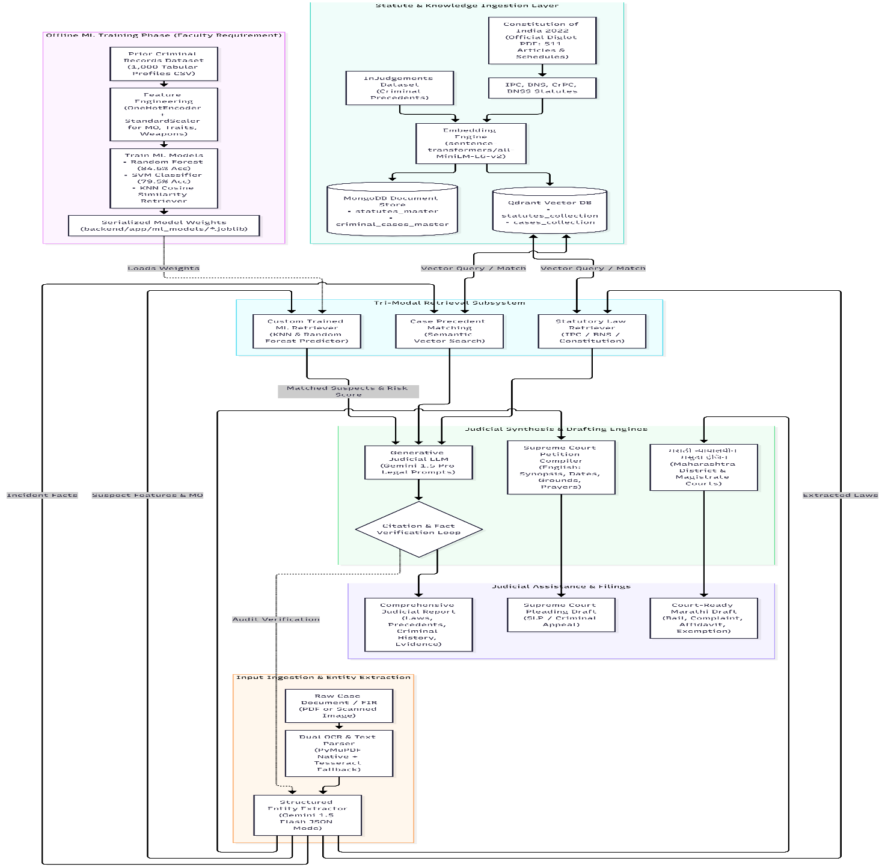
Architecture

Slide 10
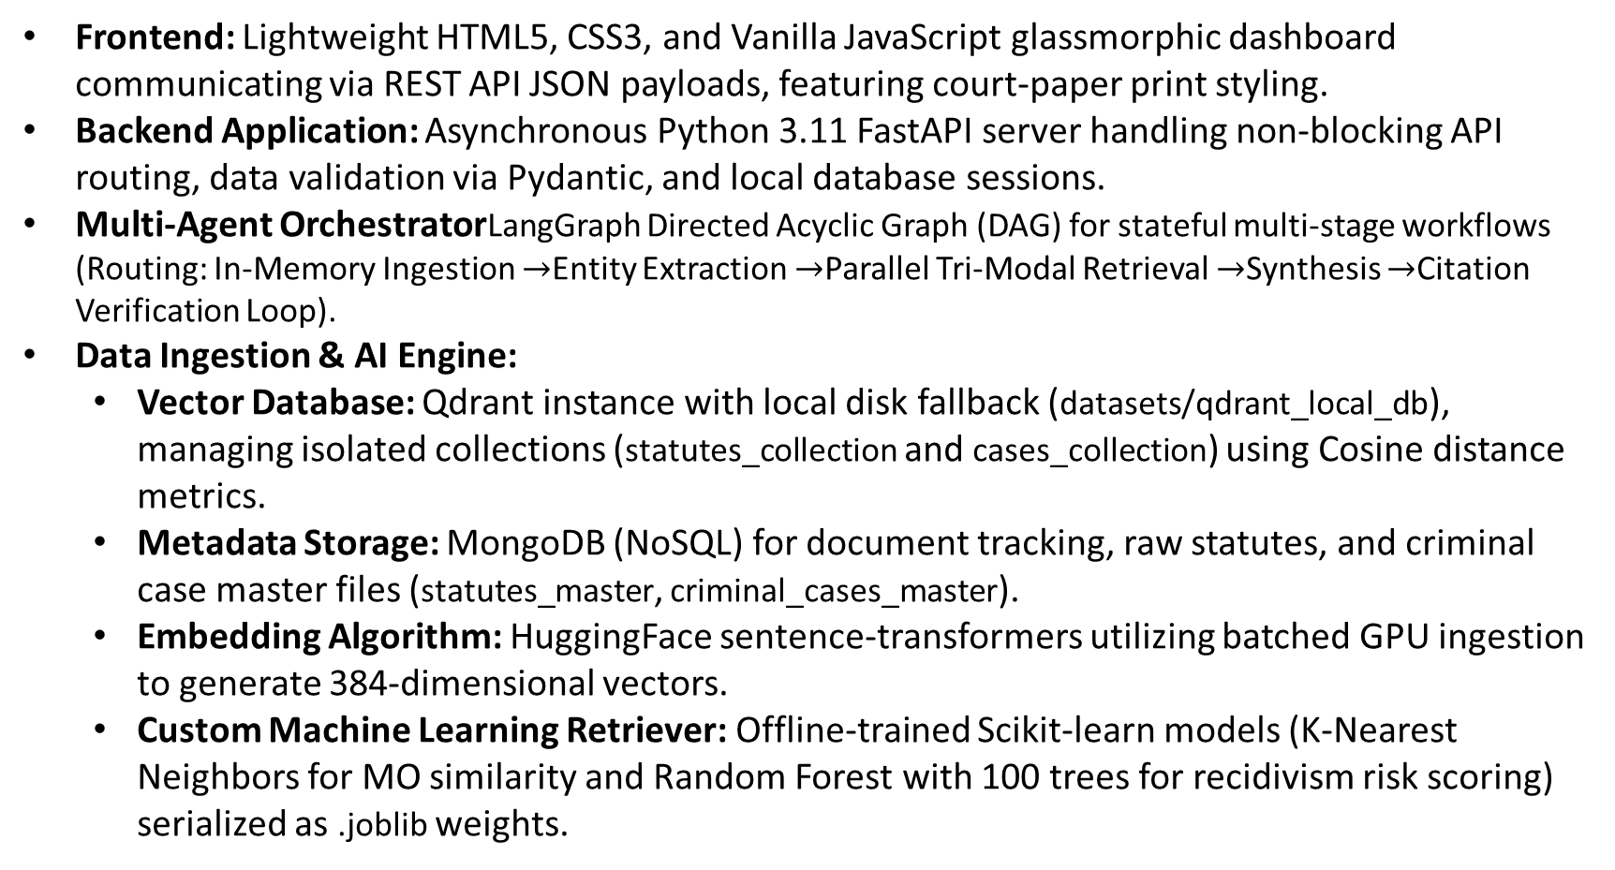
Algorithm/Mathematical Model
Frontend: Lightweight HTML5, CSS3, and Vanilla JavaScript glassmorphic dashboard communicating via REST API JSON payloads, featuring court-paper print styling.
Backend Application: Asynchronous Python 3.11 FastAPI server handling non-blocking API routing, data validation via Pydantic, and local database sessions.
Multi-Agent OrchestratorLangGraph Directed Acyclic Graph (DAG) for stateful multi-stage workflows (Routing: In-Memory Ingestion $→$Entity Extraction $→$Parallel Tri-Modal Retrieval $→$Synthesis $→$Citation Verification Loop).
Data Ingestion & AI Engine:
  Vector Database: Qdrant instance with local disk fallback (datasets/qdrant_local_db), managing isolated collections (statutes_collection and cases_collection) using Cosine distance metrics.
  Metadata Storage: MongoDB (NoSQL) for document tracking, raw statutes, and criminal case master files (statutes_master, criminal_cases_master).
  Embedding Algorithm: HuggingFace sentence-transformers utilizing batched GPU ingestion to generate 384-dimensional vectors.
  Custom Machine Learning Retriever: Offline-trained Scikit-learn models (K-Nearest Neighbors for MO similarity and Random Forest with 100 trees for recidivism risk scoring) serialized as .joblib weights.

Slide 11
References
1. Indian Legal NLP & Datasets - These papers justify the focus on the Indian legal system and validate the use of our specific datasets (ILDC, Bail Judgments).
Paul, S., Mandal, A., Goyal, P., & Ghosh, S. (2022). Pre-trained Language Models for the Legal Domain: A Case Study on Indian Law (InLegalBERT).
  Focus: Discusses the necessity of domain-specific models for Indian law and introduces InLegalBERT.
  Link: https://arxiv.org/abs/2209.06049
Malik, V., et al. (2021). ILDC for CJPE: Indian Legal Documents Corpus for Court Judgment Prediction and Explanation.
  Focus: Introduces the ILDC dataset you are using for historical precedents and case mapping.
  Link: https://aclanthology.org/2021.acl-long.313/
Kalamkar, S., et al. (2022). Named Entity Recognition in Indian Legal Judgments.
  Focus: Research on extracting specific entities (laws, locations, dates) from unstructured Indian legal text (similar to your OCR extraction node).
  Link: https://arxiv.org/abs/2211.03442
Bhattacharya, P., et al. (2019). Identification of Rhetorical Roles of Sentences in Indian Legal Judgments.
  Focus: Explains how breaking legal text into functional chunks (Facts, Arguments, Rulings) improves NLP retrieval.
  Link: https://aclanthology.org/W19-2212/

Slide 12
References
2. RAG, Semantic Search & Vector Embeddings - These papers form the mathematical and architectural foundation of our Qdrant vector database and semantic retrieval logic.
Lewis, P., et al. (2020). Retrieval-Augmented Generation for Knowledge-Intensive NLP Tasks.
  Focus: The foundational paper that introduced the RAG architecture you are using to prevent AI hallucinations.
  Link: https://arxiv.org/abs/2005.11401
Reimers, N., & Gurevych, I. (2019). Sentence-BERT: Sentence Embeddings using Siamese BERT-Networks.
  Focus: The core algorithm behind the all-MiniLM-L6-v2 transformer model you are using to generate vectors.
  Link: https://arxiv.org/abs/1908.10084
Zhai, Y., et al. (2023). A Survey on Legal Case Retrieval.
  Focus: A comprehensive overview of how algorithmic search is applied to retrieve highly relevant historical legal cases.
  Link: https://arxiv.org/abs/2311.12599
Chalkidis, I., et al. (2020). LEGAL-BERT: The Muppets straight out of Law School.
  Focus: Demonstrates how fine-tuning base LLMs specifically on legal data vastly outperforms generic language models.
  Link: https://arxiv.org/abs/2010.02559

Slide 13
References
3. Legal LLMs & Multi-Agent Orchestration - These papers support our generative synthesis, automated drafting, and stateful multi-agent workflow (LangGraph).
Cui, J., et al. (2023). ChatLaw: Open-Source Legal Large Language Model with Integrated External Knowledge Bases.
  Focus: Demonstrates an architecture very similar to Nyaya AI, combining a legal LLM with an external vector database for grounded answers.
  Link: https://arxiv.org/abs/2307.02017
Wu, S., et al. (2023). AutoGen: Enabling Next-Gen LLM Applications via Multi-Agent Conversation.
  Focus: The academic foundation for your multi-agent architecture, where different AI nodes handle OCR, retrieval, and generation sequentially.
  Link: https://arxiv.org/abs/2308.08155
Guha, N., et al. (2023). LegalBench: A Collaboratively Built Benchmark for Measuring Legal Reasoning in Large Language Models.
  Focus: Discusses how LLMs apply judicial reasoning, which justifies your system's evidentiary recommendation feature.
  Link: https://arxiv.org/abs/2308.11462
Fei, Z., et al. (2023). LawBench: Benchmarking Legal Knowledge of Large Language Models.
  Focus: Research on evaluating LLMs on their ability to map facts to statutory laws, mirroring your IPC/BNSS mapping logic.
  Link: https://arxiv.org/abs/2309.16289

Slide 14
References
4. Document Processing & System Architecture - These papers support our input methodology (FIR ingestion) and broader AI architecture.
Smith, R. (2007). An Overview of the Tesseract OCR Engine.
  Focus: The foundational computer vision paper behind the Tesseract OCR engine you are using to parse scanned FIRs.
  Link: https://ieeexplore.ieee.org/document/4376991
Zhong, H., et al. (2020). How Does NLP Benefit Legal System: A Summary of Legal Artificial Intelligence.
  Focus: A great overarching paper summarizing how AI platforms automate boilerplate workflows in the justice system.
  Link: https://arxiv.org/abs/2004.12158
Chalkidis, I., et al. (2021). LexGLUE: A Benchmark Dataset for Legal Language Understanding.
  Focus: Provides standard metrics for evaluating legal AI systems across multiple tasks like information extraction and statutory reasoning.
  Link: https://arxiv.org/abs/2110.00976

Slide 15


